Slide 1
Virtual Travel Assistant
- Team AlgoRhythm

Slide 2
Description :
Virtual Travel Assistant is an AI-powered tool that creates personalized, day-by-day travel itineraries in seconds. Just tell it your destination, trip duration, budget, and interests — and it does the rest.

Slide 3
Tech Stack :
Frontend : Next.js, JavaScript
Backend : Python, Express.js
Database : MongoDB

Slide 4
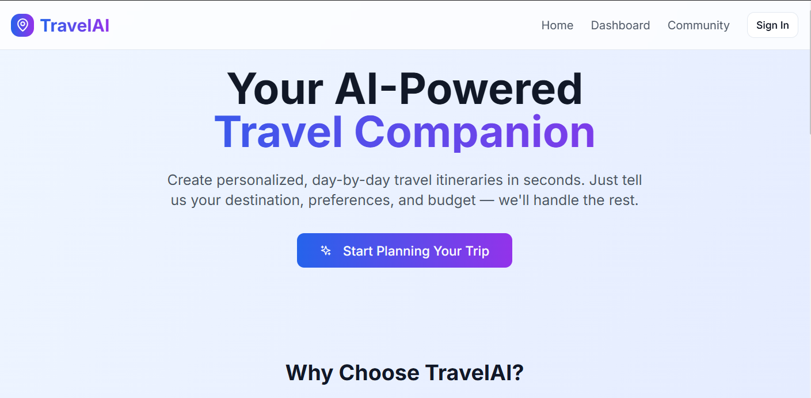

Slide 5
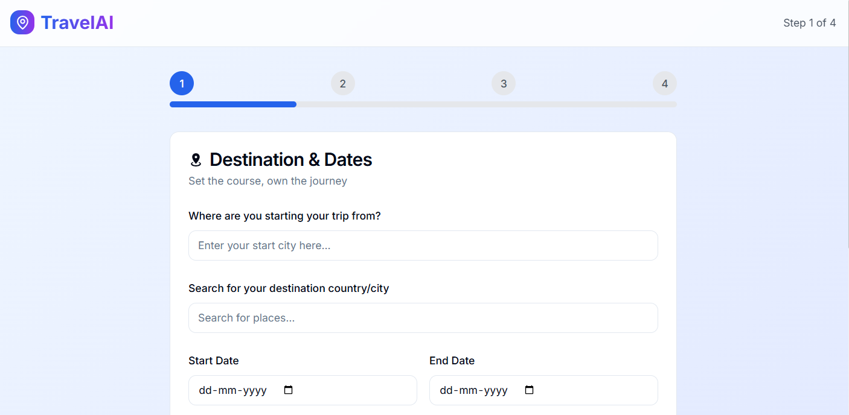

Slide 6
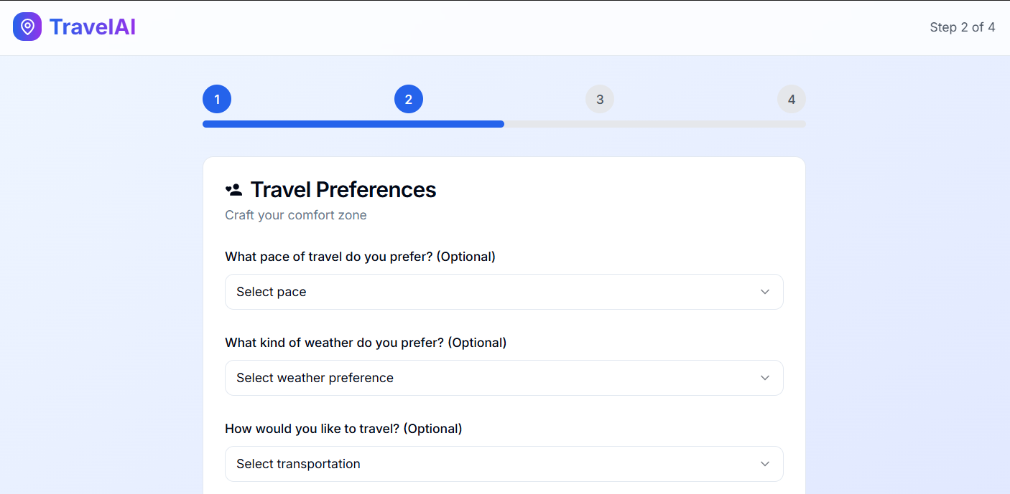

Slide 7
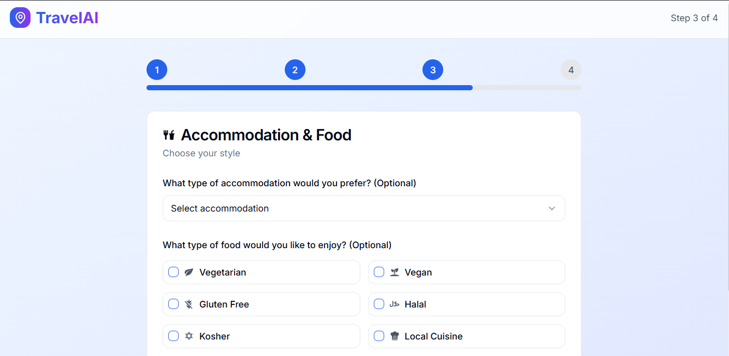

Slide 8
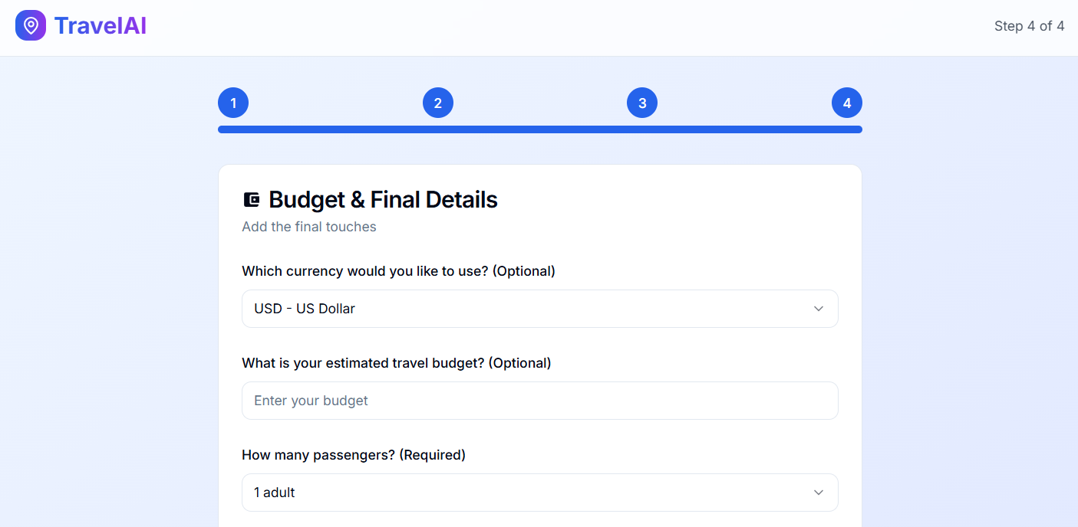

Slide 9
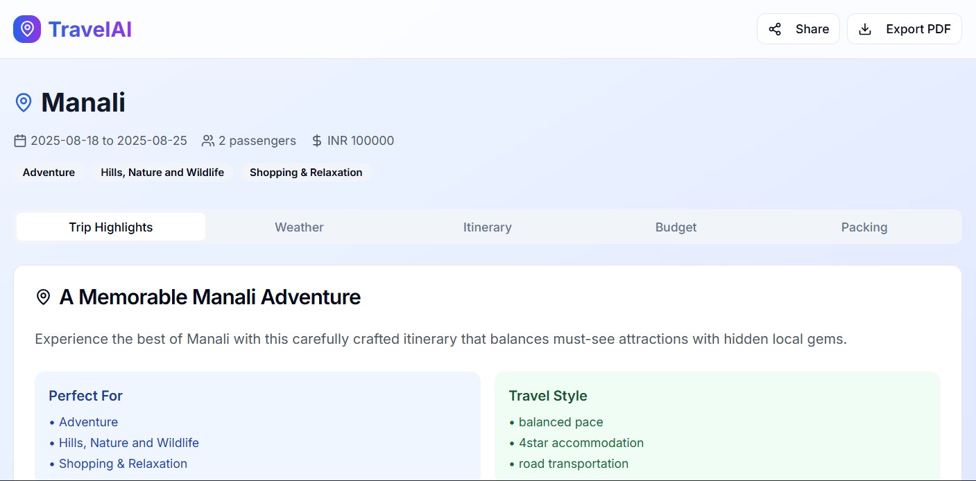

Slide 10
Features :
Accepts user input: destination, trip duration, budget, and interests
Generates personalized, day-by-day travel itineraries using AI
Integrates with external APIs to fetch real-time travel data
Filters recommendations based on user interests (e.g., nature, history, food)

Slide 11
Thank you

